Slide 1


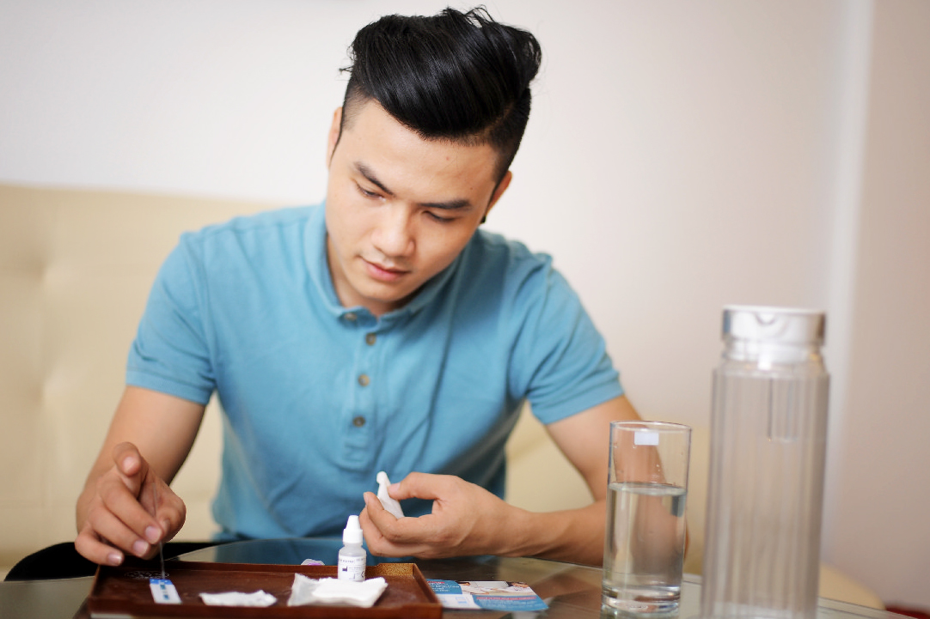
From conventional to disruptive: Up-turning the HIV testing status quo among men who have sex with men in Vietnam
Dr. Kimberly Green, PATH
kgreen@path.org

Slide 2

One size fits all before 2015…
Low and steady annual HIV testing uptake among MSM
HIV testing only available in public facilities
Sources: UNAIDS. HIV investment case, Hanoi, Vietnam, 2015;MoH, HSS+ results 2015 & 2016, Hanoi, Vietnam, 2017

Slide 3
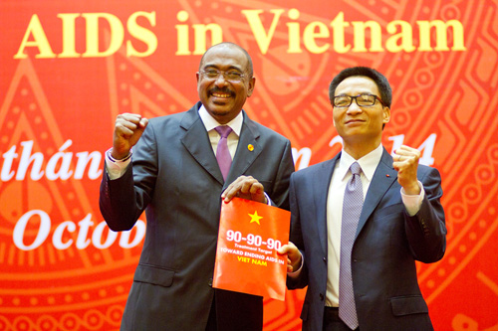
Enter 90-90-90…
Source: MOH Vietnam, December 2014

Slide 4

New services, new reach

Slide 5
Intervention description
HIV lay and self-testing pilot approved Oct 2015.
12 MSM CBOs trained to deliver HIV lay and self-testing.
Online peer influencers/HIV testing app introduced.
Lay testing initiated in December 2015; self-testing in May 2016.
Choice of a blood-based or oral fluid assay.*
Both assisted or unassisted HIVST on offer.
HIV-diagnosed MSM supported to ART enroll.
Intensive branded promotional campaign accompanied HIV lay/self-testing roll-out.**
*HIV RDT brands: Alere Determine™ HIV-1/2 and OraQuick® Rapid HIV-1/2 Antibody
** Facebook, Grindr, Hornet, MTV
Notes:
MOH approved HIV lay, self-testing pilot in Oct 2015.
12 MSM CBOs in Ho Chi Minh City (HCMC) and Hanoi trained to deliver HIV lay and self-testing.
Online peer influencers/HIV testing app also facilitated HIV lay and self-testing uptake.
HIV lay testing initiated in December 2015; self-testing in May 2016.
CBO staff offered clients a choice of a blood-based or oral fluid assay* at the CBO office.
Clients could opt to test privately without guidance from CBO staff, or could request help with the self-test.
MSM with an HIV-reactive result were accompanied by CBO staff for confirmatory testing, those HIV diagnosed were supported to ART enroll.
Intensive branded promotional campaign accompanied these new services using Facebook, Grindr, and MTV.

Slide 6
Methods

Slide 7
Methods
Descriptive analysis of MSM first-time HIV testers seeking lay or self-testing as part of a larger implementation science study that included a cross-sectional survey, and analysis of linkage to care using monitoring data, that assessed the acceptability, feasibility, and effectiveness of linkages to care of HIV lay and self-testing among KPs from December 2015 to September 2017.
Primary and secondary outcomes of interest: definitions and measures
1. First-time testers | MSM who report HIV testing for the first time ever | Cross-sectional survey
2. HIV testing preferences | MSM preferences related to HIV testing type, location, and provider | Cross-sectional survey
3. Linkage to care | MSM who test HIV reactive, are diagnosed HIV positive, and are enrolled in ART services | Quarterly service monitoring data
Notes:
The larger study involved observation and validation of lay-provider testing performance; validation of HIV self-test result interpretation; one cross-sectional survey for KPs that used HIV lay-testing (n=918) and one for KPs that self-tested (n=936); analysis of linkage to care (test-diagnose-enroll) for HIV cascade monitoring data; and focus group discussions with health managers, lay providers, and testers.
: proportion of MSM first-time HIV testers opting for HIV lay or self-testing and factors associated with first-time testing.
Secondary measures:
MSM satisfaction with HIV lay or self-testing, and testing location and provider preferences and how they had heard of lay-testing
Calculated linkage to care, including the HIV positivity rate of MSM seeking HIV lay or self-testing and the number and proportion of those diagnosed who were enrolled in ART services; included measure of linkage to care specifically for MSM who HIV lay or self-tested through a social media-based referral or booking

Slide 8
Methods (2)
548 MSM accessing HIV lay provider testing and 803 MSM seeking HIVST opted to participate in the larger study.
Analysis:
  The main outcome of interest:
    Univariable logistic regressions were conducted to identify socio-behavioral factors independently associated with first-time HIV testers and analyzed separately for MSM selecting HIV lay provider testing and self-testing.
    Variables found to be statistically associated with a p-value of <0.05 were included in the multivariable logistic regression model.
    The final model was generated using backward elimination of variables with a p-value of <0.05.
  The linkage to care cascade data were analyzed and visualized by applying the 2015 LINKAGES guide.
Notes:
The larger study

Slide 9
Key results

Slide 10
Reaching new HIV testers
First time & infrequent testers
Factors associated with being a first-time HIV tester and opting for lay provider testing
Characteristics | MSM
 | Self-testing (n=803) | Lay-testing (n=548)
Ever been HIV tested
No, this is first time | 51.3% | 57.9%
Yes | 48.7% | 42.1%
HIV tested in past 12 month | (n=391) | (n=233)
No | 22.5% | 35.2%
Yes | 77.5% | 64.8%
Final adjusted model, MSM first-time testers higher odds of:
never exchanging sex for money (aOR 2.3; 95% CI:1.35–2.9) or
having an income below the mean (aOR 1.6; 95% CI:1.1–2.3).
Factors associated with being a first-time HIV tester and opting for self-testing
In final adjusted model, MSM having attained a lower level of education had higher odds of being a first-time tester (aOR 1.8; 95% CI:1.3–2.5).
Source: USAID/PATH Healthy Markets HIV Lay and Self-Testing Pilot Evaluation Results, November 23, 2017.

Slide 11
Age, information source, preferences
Peer outreach (71%)
Friend (63%
Facebook (55%)
Median age of MSM seeking…
Top3 sources of information where MSM first heard about HIV lay testing
23
24
Lay-testing
Self-testing
Satisfied with services
HIVST preferences…
98%
94%
Lay-testing
Self-testing
Notes:
Define HIVST quicly

Slide 12
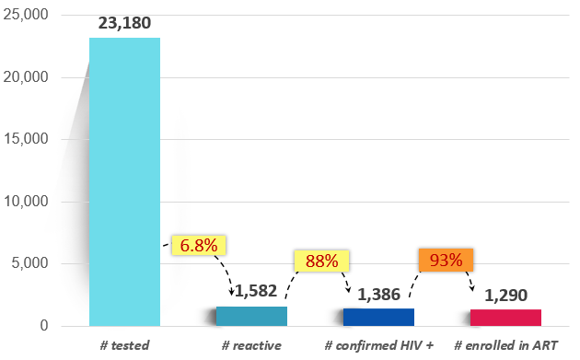
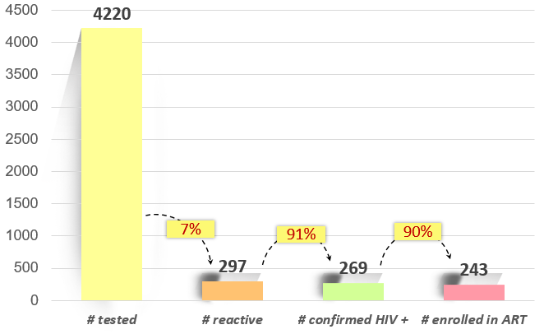
HIV lay and self-testing cascades
HIV lay-testing cascade among MSM in HCMC & Hanoi, Jan 2016 to Sept 2017
HIV self-testing cascade among MSM in HCMC & Hanoi, May 2016 to Sept 2017
Online-to-offline cascade: March 2016 to Sept 2017, 2,454 MSM clients were counseled and screened for HIV risk by social media peers or booked an HIV test online through I Reserve app, 73.2 % of which successfully sought HIV lay provider or self-testing;
11% (n=198) were confirmed HIV positive and 100 % enrolled in ART
Notes:
2,067 MSM were counseled and screened for HIV risk by social media influencers, 1,429 (69.1%) were referred for an HIV test based on their HIV risk profile, 1,419 were tested (99.3%), and 10.9% (n=155) were HIV diagnosed.
A total of 387 MSM used the newly launched I Reserve app, 367 were HIV tested (94.8%), and 11.1% (n=43) were HIV diagnosed. All 198 of those diagnosed were enrolled in ART services.

Slide 13
Key Takeaways
HIV lay and self-testing attracted a substantial proportion of new and young testers, social media content likely played an important role.
New HIV testers were more likely to not be exchanging sex for money, have a lower income and lower level of education suggesting HIV lay/self-testing are reaching different segments of at-risk MSM in a way that traditional HIV testing services are not.
MSM-CBOs were very effective at reaching large numbers of MSM, and successfully facilitating their diagnosis and ART enrollment.
Social media-based interface offers the potential to reach MSM at higher risk of HIV.
Notes:
have a lower income, never have exchanged sex for money, and have attained lower levels of education. Studies in higher and lower-income countries have both identified younger age and lower education attainment with never having tested for HIV [28,29,30]. This suggests that HIV lay and self-testing are reaching at-risk MSM in a way that traditional HIV testing services are not equipped to.

Slide 14
Limitations, future research & conclusions
Limitations. Descriptive study (not able to directly compare to facility-based testing uptake, yield, ART enrollment), not based on a probability sample nor necessarily representative.
Future research. RCTs on impact of social media on HIV testing uptake, studies that explore HIV lay/self-testing and PrEP uptake, and evaluation of diverse HIVST distribution models.
Conclusion. MSM-led HIV lay and self-testing, promoted through online or face-to-face interactions, could significantly contribute to epidemic control in Vietnam by increasing diagnosis of harder-to-reach and higher-risk MSM and facilitating ART (and PrEP) enrollment.

Slide 15
Authors
Kimberly Elizabeth Green¹; Bao Ngoc Vu¹; Huong Thi Thu Phan²; Minh Hung Tran³; Huu Van Ngo¹; Son Hai Vo²;Trang Minh Ngo⁴; Anh Hong Doan¹, Tham Thi Tran¹; Trang Nguyen Nhu Nguyen⁵; An Bao¹; Lan Thi Xuan Hang⁵; Thanh Minh Le⁶; Tung Thanh Doan⁷; Linh Hong Dang;³ and Giang Thi Tra Ha¹
1) PATH; 2) Ministry of Health/Vietnam Administration of HIV/AIDS Control; 3) Center for Creative Initiatives in Health and Population; 4) United States Agency for International Development; 5) Life Center; 6) G-link Social Enterprise; 7) Lighthouse Social Enterprise
Acknowledgements
CBOs/Social enterprises/Private clinics: Lighthouse, G-Link, G3VN, Aloboy, M4M, Color of Life, Vuot Song, Smile, V-Smile, SHP, Kid’s Sun, Love Boy, Suc Moi, Song Tre, Niem Tin Xanh, I Girls, We are Students
MoH/VAAC: Assoc. Prof Dr. Nguyen Hoang Long, Dr. Pham Duc Manh, Dr. Hoang Dinh Canh
Ho Chi Minh City PAC: Dr. Tieu Thi Thu Van; Hanoi PMC: Dr. La Thi Lan
USAID Vietnam: Ms. Nguyen Thi Minh Huong, Dr. John Eyres, Ms. Mei Mei Peng
PATH: Dr. Johannes van Dam, Mr. Nguyen Viet Dung, Dr. Tran Thi Huong Lien
WHO: Nguyen Thuy Thi Van

